Slide 1
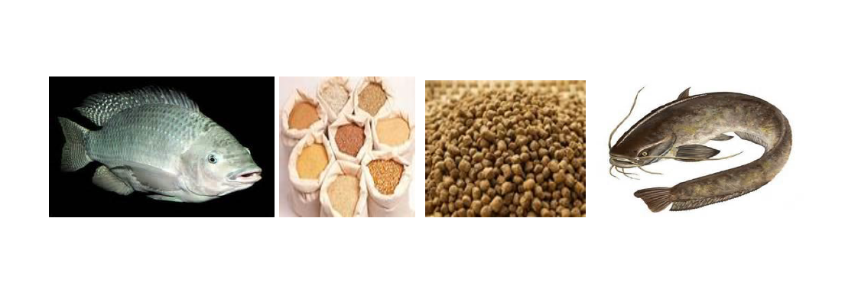
PRODUCTION AND FORMULATION OF FISH FEED
Joseph Mphande
MSc Sustainable Aquaculture –University of Stirling, UK
MSc -Aquaculture and Fisheries Science-LUANAR, Malawi.
Email: josephmphande90@gmail.com

Slide 2
INTRODUCTION
REMEMBER: We briefly discussed natural food, supplemental and complete complete feed.
NATURAL FOOD
Fish food consists of natural food and artificial (manufactured) feeds.
In natural waters and well-fertilized ponds, microscopic plants (phytoplankton), microscopic animals (zooplankton), insects, crustaceans, copepods and molluscs are examples of natural foods.
Natural food organisms in the water will provide essential nutrients.

Slide 3
INTRODUCTION
REMEMBER: We discussed natural food, supplemental and complete complete feed.
SUPPLEMENTAL FEED
When natural foods are not available in sufficient quantity to provide adequate nutrients for fish growth and development, supplementary feeds and supplement natural foods.
They are not nutritionally complete and will not adequately support fish growth in the absence of natural foods.
Some examples of supplementary fish feeds are commercially produced rations for chickens and pigs, rice bran, cassava leaves, kitchen refuse, oil seed cakes or other agricultural products and by products.

Slide 4
INTRODUCTION
REMEMBER: We discussed natural food, supplemental and complete complete feed.
COMPLETE FEED
In the total absence of natural foods as it is the case with recirculating aquaculture and indoor system, nutritionally complete manufactured feeds that contain all essential nutrients must be fed to fish.
Artificial complete (or balanced) feeds are well-compounded mixture of feedstuffs and can be in mash or pellets form that could be fed to fish.

Slide 5
INTRODUCTION
REMEMBER: We discussed natural food, supplemental and complete complete feed.
COMPLETE FEED
Mash feeds are good for fry and pellets for fingerlings, juveniles and adults depending on pellet size.
Although the use of artificial feeds may be costly, especially the commercially compounded ration, they have the following advantages in fish culture:

Slide 6
INTRODUCTION
REMEMBER: We discussed natural food, supplemental and complete complete feed.
ADVANTAGES OF COMPLETE FEED
Enable high stocking density (stocking maximization) especially in polyculture system;
They promote faster growth of fish, since food will always be available;
High fish yield is guaranteed relative to the stocking density;
Uneaten artificial feeds in the pond water will be biologically degraded hence acting as fertilizer to promote plankton growth
A fish farmer while feeding the fish can study the behaviour (activity) of fish and monitor their health.

Slide 7
INTRODUCTION
REMEMBER: We discussed natural food, supplemental and complete complete feed.
Good quality feed is key to fish production and profitability of the venture.
Feed has a direct impact on growth rate, productivity and animal health as well as farm profit
The following are importance of good quality feed:
Good quality feed increases the income of producer
Absence of good quality food can predispose fish to diseases
Good quality feed improves yield or quality of fish product.

Slide 8
INTRODUCTION
Why do we need to formulate or produce complete feed?
No single feed ingredient can supply all the nutrients and energy required for optimal bodily or gonadal growth, health and well being of the species concerned;as such, a mixture of feed ingredient is combined to produce a diet with the desired nutrient profile of target species.

Slide 9
INTRODUCTION
But what is the meaning of feed formulation?
Determining the quantity of various ingredients in the feed mixture
Based on the specific requirements of the specific nutrients by the fish
Stage of growth and development
Feed formulation involves selecting a combination of ingredients which will produce a mixture containing levels of essential nutrients at or above the minimum requirements of the fish.

Slide 10
INTRODUCTION
WHAT ARE THE OBJETIVES OF FEED FORMULATION?
Satisfy all known nutrient requirements for growth of the species.
Minimize feed cost (Buying ingredients, cosst of formulation, trasportation, cost of feeding)
Select and use ingredients that will result in products that are readily utilized to minimize wastage.

Slide 11
INTRODUCTION
WHAT TYPE OF INFORMATION DO YOU NEED TO PROPERLY FORMULATE AQUA-FEEDS?
Nutritional required of the target species
Fish physiology (Digestive system, feeding behavior)
Nutritional values of various ingredients used in the feed mixture
The specific functions of the ingredients in the metabolism

Slide 12
INTRODUCTION
WHAT TYPE OF INFORMATION DO YOU NEED TO PROPERLY FORMULATE AQUA-FEEDS?
Cost of ingridients and other economic reason (binders and antioxidants).
Availability of ingredients
Ingredient digestibilities (The measurement of the proportion of energy and nutrients, which an animal can obtain from a particular ingredient through its digestive and absorptive processes)

Slide 13
INTRODUCTION
WHAT TYPE OF INFORMATION DO YOU NEED TO PROPERLY FORMULATE AQUA-FEEDS?
Ingredient palatability (Defined as the combination of both attractiveness and ingestion of a diet and therefore of most relevance to feed development)
Nutrient utilization
Age of fish: the life stage of fish determines the nutritional requirement for the fish.
Younger fish need feed with high of quality protein, which is easily digestible.
In some species such as catfish, crude protein in feed for fingerlings is above 45% while in adult fish is may be around 30%.

Slide 14
INTRODUCTION
WHAT TYPE OF INFORMATION DO YOU NEED TO PROPERLY FORMULATE AQUA-FEEDS?
Specie: (carnivores, Onmivorous, herbivores).
This feeding behavior determines to a large extent what they accept as feed or food.
Nutritional composition: this is the information on the proportion of nutrients contained in feed ingredients; this information includes crude protein, carbohydrates, crude fat, vitamins, minerals and gross energy.

Slide 15
INTRODUCTION
WHAT TYPE OF INFORMATION DO YOU NEED TO PROPERLY FORMULATE AQUA-FEEDS?
Anti-Nutritional factors: these are biological compounds present in feed ingredient that cause disease in fish and thus reduce nutrient utilization and fish growth.
Anti-nutritional factors include: gossypol, tannin, saponin, cyanogenic glycosides, lectins, protease inhibitors, toxic amino acid etc.
Danger-free: some feed ingredients may contain harmful substances like plastic, pieces of metals, nylon and even heavy metals.
Stability: this is the ability of feed ingredients to maintain unchanged quality when stored.

Slide 16
INTRODUCTION
WHAT IS THE MEANING OF THE FOLLOWING STATEMENT?
A feed is only as good as its ingredients.

Slide 17
INTRODUCTION
No single feed ingredient can supply all the nutrients and energy required for optimal growth;as such, a mixture of feed ingredient is combined to produce a diet with the desired nutrient profile of target species.

Slide 18
FEED STUFFS
Feedstuffs are ingredients used to manufacture fish feeds.
Artificial feeds are produced by carefully selecting and blending ingredients to provide highly nutritional diets that induce high growth, maintain the health of the fish and increase the quality of fish flesh and associated end products as fish oil and fish eggs.

Slide 19
FEED STUFFS
Feeds and feed stuffs contain the energy and nutrients essential for the growth, reproduction and health of aquatic animals.
Dietary nutrients are essential for the construction of living tissues.
They also are a source of stored energy for fish digestion, growth, reproduction and the other life processes.

Slide 20
FEED STUFFS
Feedstuffs for fish could be dry or wet but Dry feedstuffs are easy to store, transport and distribute to farmers or end users.
Examples of dry feedstuff include: palm kernel cake, soy bean meal, fish meal, cereals etc. On the other hand, wet feedstuffs require special treatment before they can be fed to fish.
Examples of wet feedstuffs include: brewery waste and molasses.

Slide 21
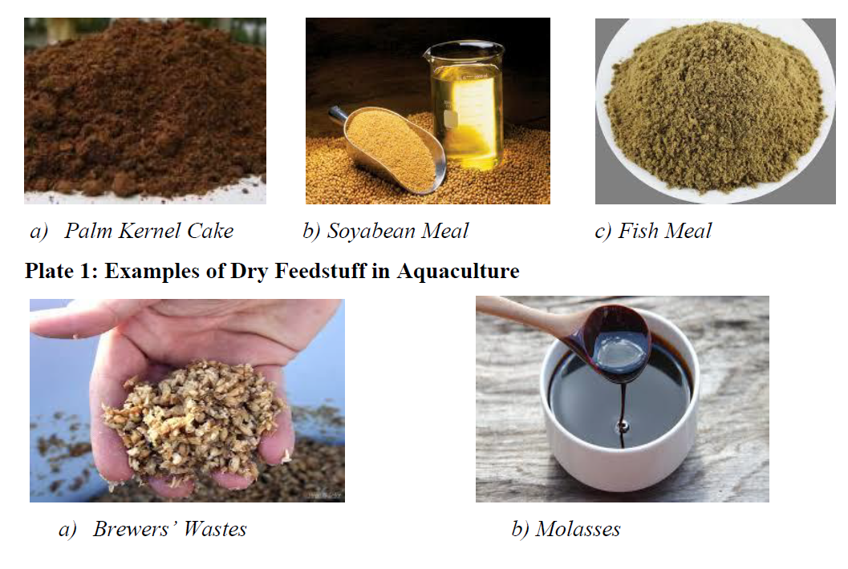
FEED STUFFS

Slide 22
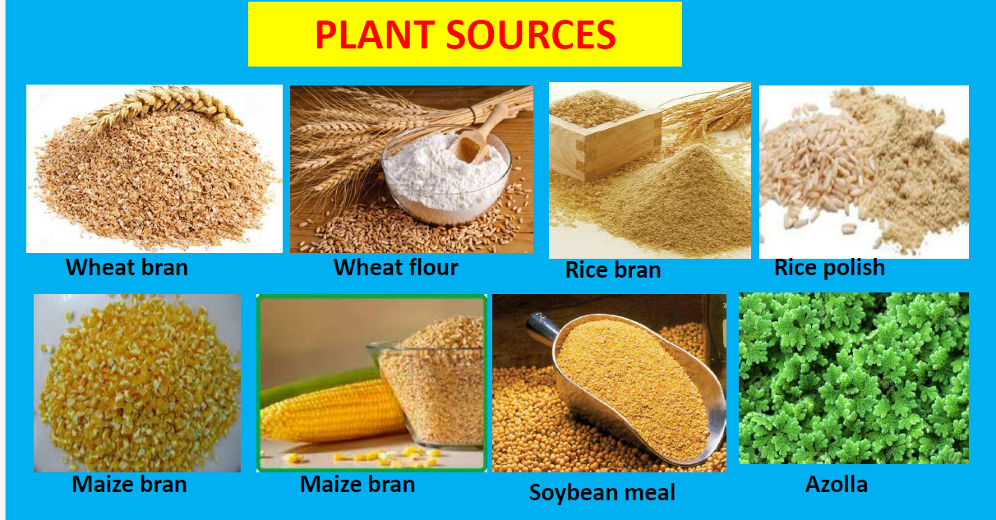
FEED STUFFS

Slide 23
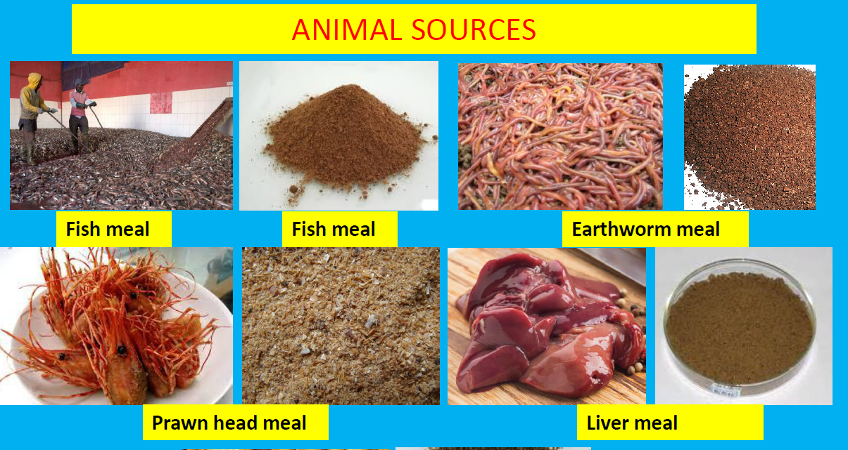
FEED STUFFS

Slide 24
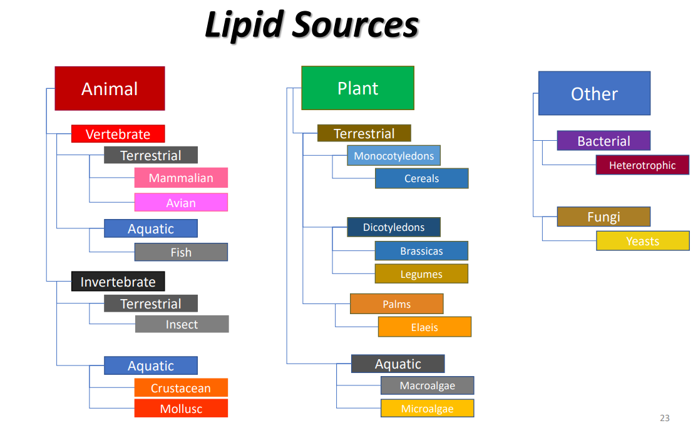
Feed ingredients and sources

Slide 25
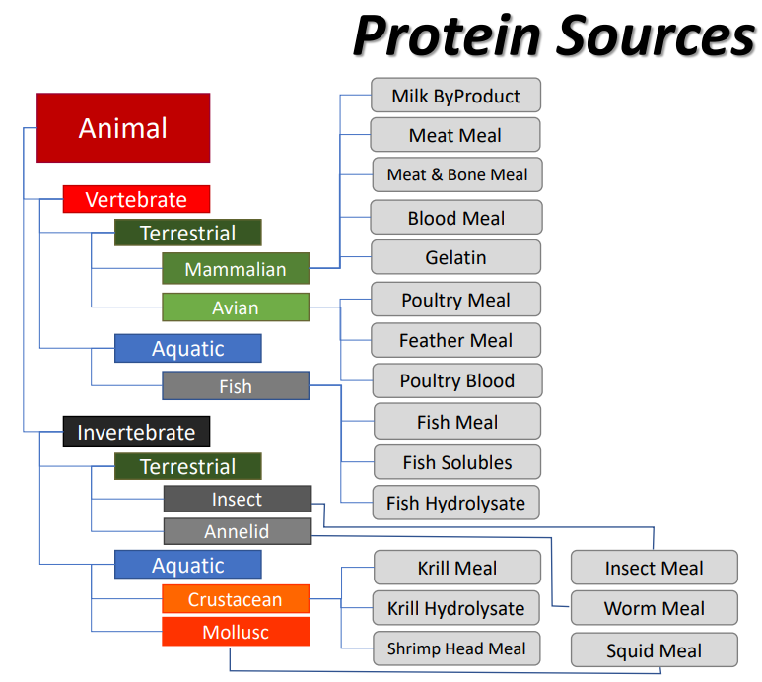
Feed ingredients and sources

Slide 26
FEED STUFFS
Feedstuffs are classified into two major groups in fish culture
i. Energy Feedstuffs: These are feedstuffs containing less than 20% crude protein usually of plant origin (cassava, wheat offal, rice bran, maize, guinea corn)
ii. Protein Supplements: These are feedstuffs containing 20% crude protein or more and maybe of plant or animal materials origin but Protein of animal origin is of higher quality than those of plant origin.
Examples of animal protein sources in fish culture are fishmeal, bone meal, blood meal, poultry meal.
Soybean meal, groundnut cake and cottonseed cake are some examples of plant protein materials.

Slide 27
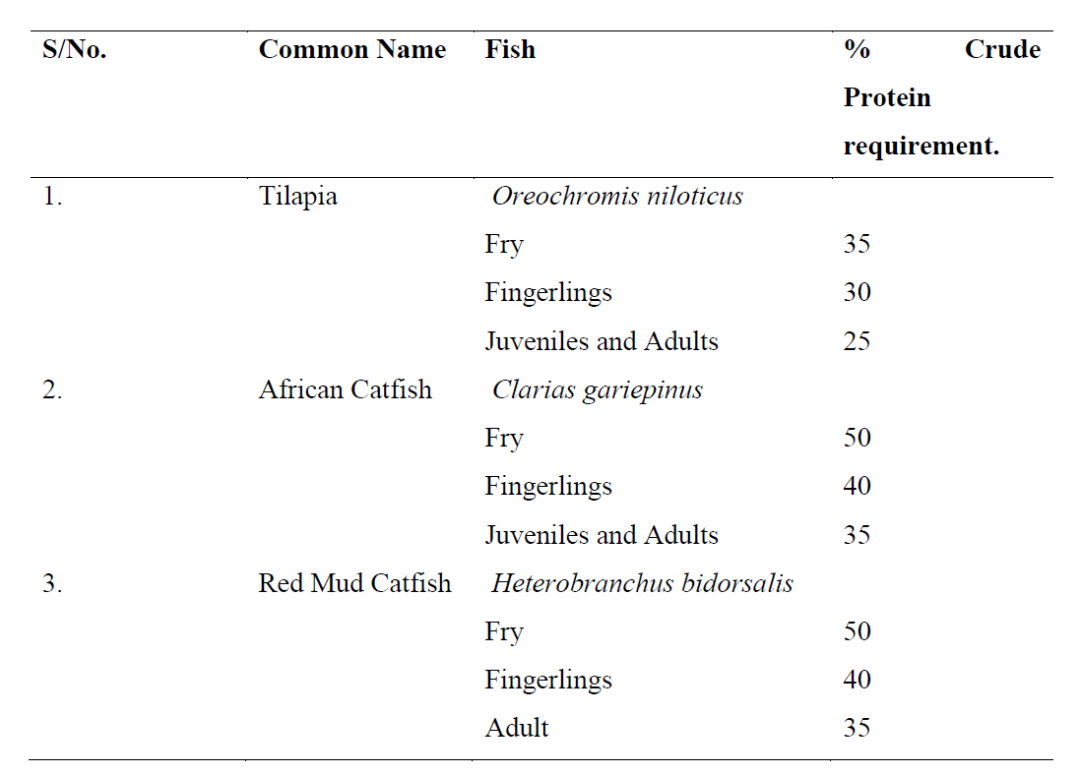
FEED STUFFS
The dietary protein requirements for catfish and tilapia at various stages of growth

Slide 28
NUTRIENTS REQUIREMENT OF THE FISH
Nutrient requirement of fish refers to the lowest amount of nutrients necessary for good growth and health in fish.
Nutritional requirement varies with species and life stage of fish.
To achieve optimum growth and production of fish, fish diet must be formulated to meet all nutrient requirements of the fish.

Slide 29
NUTRIENTS REQUIREMENT OF THE FISH
There are six classes of nutrients
Carbohydrate: serves as a source of energy in fish feed. Meanwhile less of it is needed in carnivorous fishes; they are also used as binders.
Protein: this is important for synthesis and building of body tissues, growth maintenance, reproduction, enzymes and hormones, egg production, etc. Protein is a source of small amount of energy.
Fats: serves as a source of large amount of energy to fish. They also provide essential fatty acids that are needed for physiological processes.
Minerals: these are inorganic chemicals required for normal health and growth, they also control physiological processes.
Vitamins: these are organic chemicals needed in small amounts and required for normal health and growth; they also control body enzymatic processes.
Water: this is the universal solvent, needed in all bodily processes.

Slide 30
NUTRIENTS REQUIREMENT OF THE FISH
Factors that affect nutritional requirements of fish are:
Genetics: variation in species may also mean variation in nutritional requirement. Growth rate potential and efficiency of absorbing and utilization of nutrients in fish feed will determine the nutrient inclusion.
Life stage or age: nutrient requirement is related to stage of maturity of fish and its body weight.
Reproductive state: female broodfish producing eggs and male broodfish producing milt will need nutrient different from a fry. Nutrients that meet present anabolic need of the fish is important.
Temperature of environment: nutritional requirement may also depend on ambient temperature of the water derived from the climate of the location of the farm.

Slide 31
NUTRIENT COMPOSITION OF FEEDSTUFFS
There are six nutrients as discussed above; water, carbohydrates, lipids, proteins, minerals, and vitamins.
Fish derive energy from three of these nutrients: lipids, proteins, and carbohydrates (the chemical energy or heat density available for the animal to use in 1 gram of fat, protein, and carbohydrate is approximately 9, 4, and 4 kilocalories, respectively).

Slide 32
NUTRIENT COMPOSITION OF FEEDSTUFFS
The term nutrient-density refers to the amount and type of a particular nutrient, or combination of them, contained in a feed, usually a pellet of specific size or volume.
For example, a high-performance grow-out pellet may contain a high concentration of protein to supply amino acids necessary to build muscles and support fast growth.
In order to increase the nutrient and energy density of a feed, something has to be taken out to provide room for the selected nutrient. What is decreased in the diet is usually carbohydrate, particularly in fish feeds.

Slide 33
NUTRIENT COMPOSITION OF FEEDSTUFFS
Most species of fish derive energy from proteins and fats more efficiently than from carbohydrates
The moisture content of a feed pellet also will influence its nutrient and energy densities because more water adds weight but no nutrients or calories

Slide 34
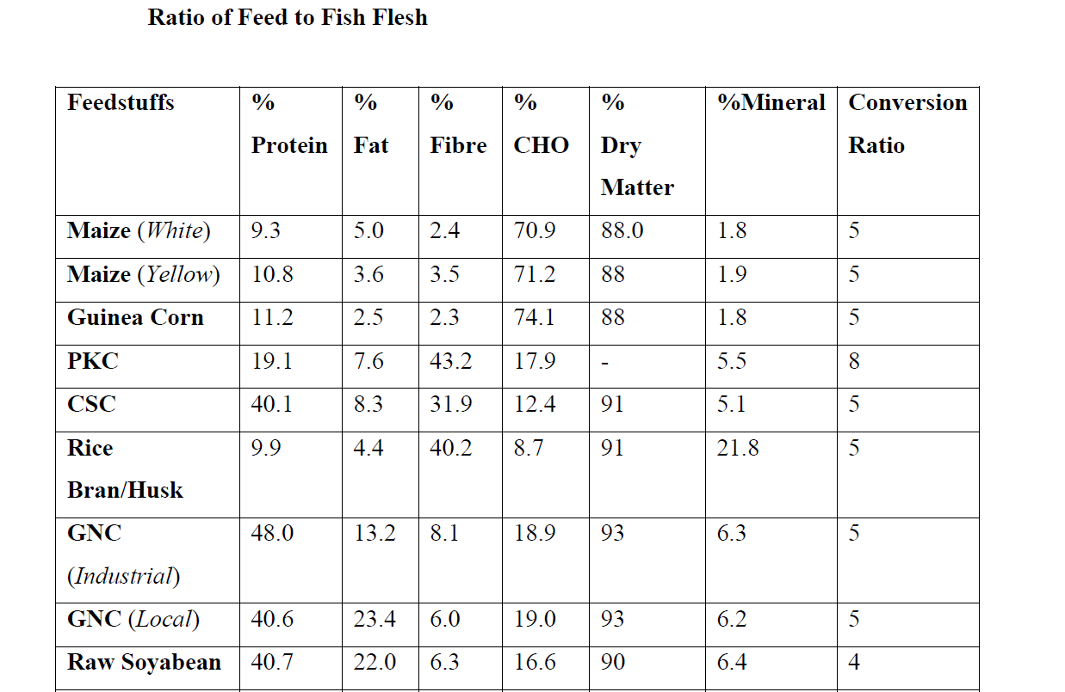
NUTRIENT COMPOSITION OF FEEDSTUFFS

Slide 35
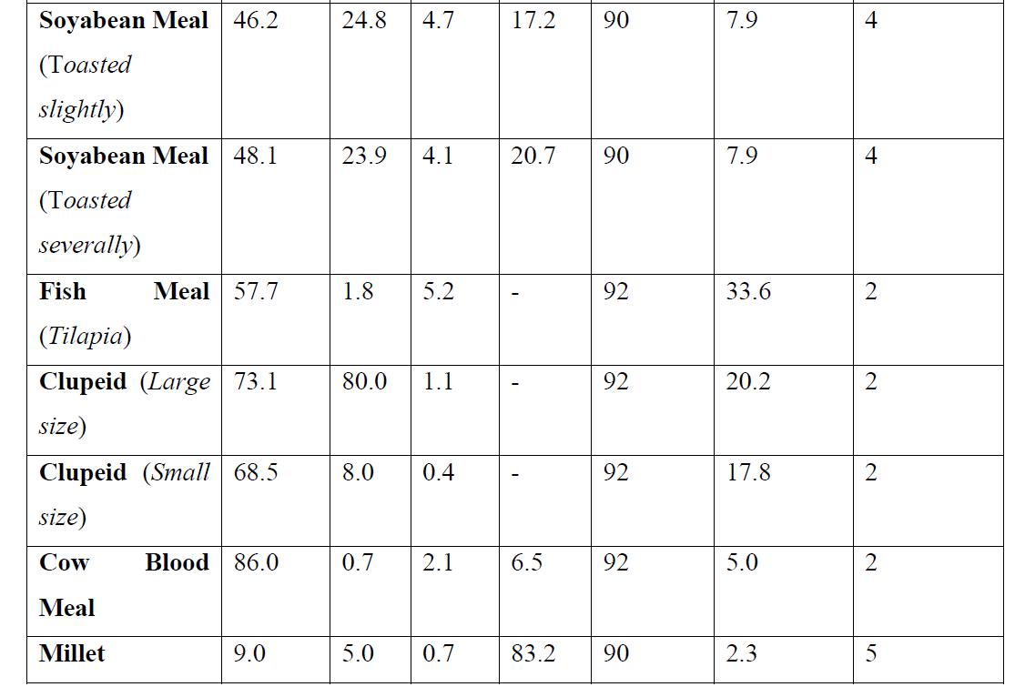
NUTRIENT COMPOSITION OF FEEDSTUFFS

Slide 36
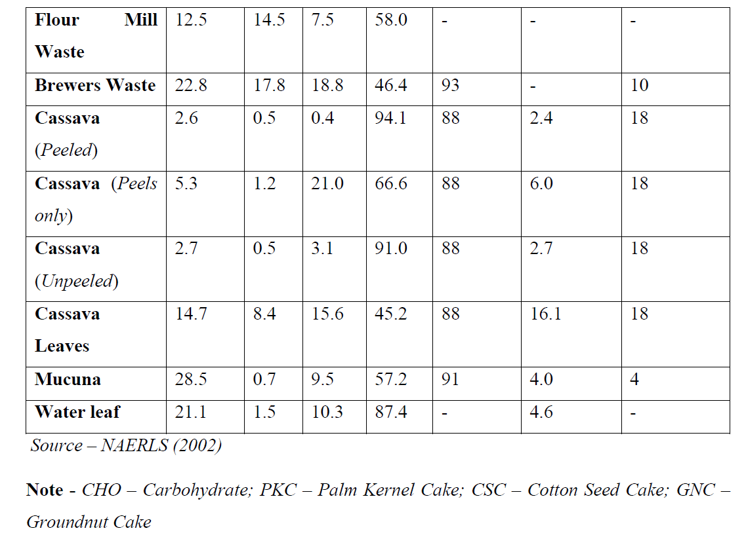
NUTRIENT COMPOSITION OF FEEDSTUFFS

Slide 37
PROCESSING OF THE FEEDSTUFFS
Most feedstuffs have anti-nutritional factors, which will be harmful to fish.
The anti-nutritional factors alter the nutritional value of the feedstuffs and affect the health of fish.
They may be inherent in the foodstuffs or contaminants on the feedstuffs. They prevent easy digestion of nutrients in the feed.
One of the ways to destroy anti-nutritional factors is to heat-treat the feedstuffs.
Heat destroys such factors e.g. tripsin inhibitors in raw soybean or groundnut and gossypol in cottonseed.
Processing feed stuffs may also include one or a combination of grinding, soaking or pelleting

Slide 38
PROCESSING OF THE FEEDSTUFFS
Sources of nutrients for fish feed are:
Proteins and Amino Acids - Fish meal, soybean meal, fish hydroxylate, skim milk powder, legumes, wheat gluten, and many plant-based concentrates (corn protein concentrate, sunflower concentrate, etc.) are excellent sources of protein.
Additionally, the building blocks of proteins (free amino acids) such as crystalline lysine and methionine are commercially available to supplement the diet.
Lipids - Oils from marine fish, vegetable oils from canola, sunflower and linseed, are common sources of lipids in fish feeds.

Slide 39
PROCESSING OF THE FEEDSTUFFS
Sources of nutrients for fish feed are:
Carbohydrates - Cooked carbohydrates, from flours of corn, wheat or other cereals, are relatively inexpensive sources of energy that may spare protein (which is more expensive) from being used as an energy source.
Vitamins and Minerals - The variety and number of vitamins and minerals are so complex that they are usually prepared synthetically and are available commercially as a balanced and pre-measured mixture known as a vitamin or mineral premix.
This premix is added to the diet in generous amounts (1-2%) to ensure that adequate levels of vitamins and minerals are supplied to meet dietary requirements.

Slide 40
PROCESSING OF THE FEEDSTUFFS
Sources of nutrients for fish feed are:
Pigments - Carotenoids are available to enhance colors red and yellow coloration in the flesh and the skin of freshwater and marine ornamental fish.
The synthetically produced pigment, astaxanthin is the most commonly used additive (100–400 mg/kg).
Cyanobacteria (blue-green algae’ dried shrimp meal, shrimp and palm oils, red peppers and yeast are excellent natural sources of pigments.
Binding Agents - Another important ingredient in fish diets is a binding agent to provide stability to the pellet and reduce leaching of nutrients into the water.

Slide 41
PROCESSING OF THE FEEDSTUFFS
Sources of nutrients for fish feed are:
Preservatives - Preservatives, such as antimicrobials and antioxidants, are often added to extend the shelf-life of fish diets and reduce the rancidity of the fats.
Vitamin E is an effective, but expensive, antioxidant that can be used in laboratory prepared formulations.
Sodium and potassium salts of propionic, benzoic or sorbic acids, are commonly available antimicrobials added at less than 0.1% in the manufacture of fish feeds.
Ethoxyquin (EMQ) is also used as a feed preservative in certain countries to prevent mold.

Slide 42
PROCESSING OF THE FEEDSTUFFS
Sources of nutrients for fish feed are:
Stimulant and attractants - Other common additives incorporated into fish feeds are chemo-attractants and flavorings, such as fish hydroxylates and condensed fish soluble (typically added at 0.5-2% of the diet).
The amino acids glycine and alanine, and the chemical betaine are also known to stimulate strong feeding behavior in fish.
Basically, attractants enhance feed palatability and stimulant enhance feed intake.

Slide 43
PROCESSING OF THE FEEDSTUFFS
Sources of nutrients for fish feed are:
Other Feedstuffs. Fiber and ash (minerals) are a group of mixed materials found in most feedstuffs.
In experimental diets, fiber is used as a filler, and ash as a source of calcium and phosphorus.
A high fiber and ash content reduce the digestibility of other ingredients in the diet resulting in poor growth of the fish.

Slide 44
SIMPLE QUESTIONS
1. Which of the following is a feedstuff for fish?
(a) Cassava, (b) Rice; (c) Groundnut cake
2. Which of the following is not an anti-nutritional factor?
(a) Cyanogenic glycosides; (b) Tannin; (c) Chitin
3. Carbohydrate included in fish feed can serve the purpose of:
(a) Binding; (b) Repairing worn out tissues; (c) Enhancement of bodily processes
4. Protein included in fish feed can serve the purpose of:
(a) Binding; (b) Repairing worn out tissues; (c) Enhancement of bodily processes

Slide 45
CASE STUDY OF TILAPIA NUTRITIONAL REQUIREMENTS
The Nile tilapia (Oreochromis niloticus) is a widely cultured species because it grows and reproduces in a wide range of environmental conditions and tolerates stress induced by handling.
Nile tilapias are omnivores in feeding habits with an herbivore tendency.
Tilapia can thus feed on a wide range of both natural and artificial foods.
Nile tilapia has considerable potential for aquaculture in many tropical and subtropical regions in the world

Slide 46
CASE STUDY OF TILAPIA NUTRITIONAL REQUIREMENTS
Attributes that contribute to the popularity of Nile tilapia farming in ponds include
Easy breeding, fast growth, tolerance of adverse environmental conditions, good taste, good market price, high tolerance to low water quality, efficient food conversion, resistance to disease and good consumer acceptance.

Slide 47
CASE STUDY OF TILAPIA NUTRITIONAL REQUIREMENTS
The major nutrient requirements of cultured tilapia show that early juvenile fish (0.02-10.0 g) would require a diet higher in protein, lipids, vitamins and minerals and lower in carbohydrates.
Sub-adult fish (10-25 g) require more energy from lipids and carbohydrates for metabolism and a lower proportion of protein for growth.
Adult fish (>25.0 g) would require even less dietary protein for growth and can utilize even higher levels of carbohydrates as a source of energy.

Slide 48
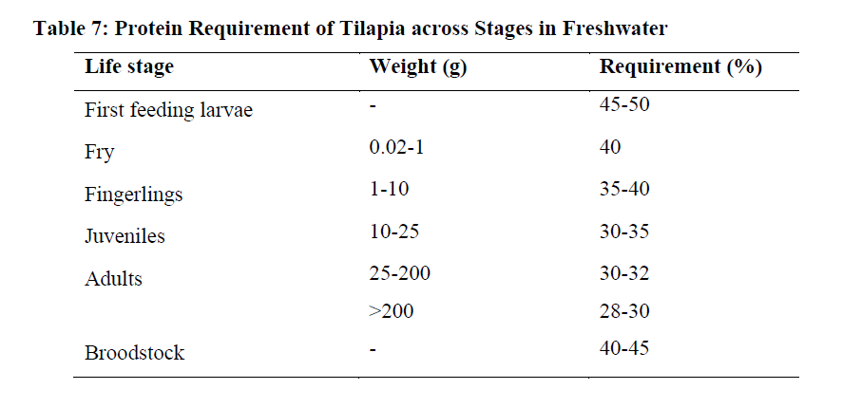
CASE STUDY OF TILAPIA NUTRITIONAL REQUIREMENTS

Slide 49
CASE STUDY OF TILAPIA NUTRITIONAL REQUIREMENTS
The major nutrient requirements of cultured tilapia show that early juvenile fish (0.02-10.0 g) would require a diet higher in protein, lipids, vitamins and minerals and lower in carbohydrates.
Sub-adult fish (10-25 g) require more energy from lipids and carbohydrates for metabolism and a lower proportion of protein for growth.
Adult fish (>25.0 g) would require even less dietary protein for growth and can utilize even higher levels of carbohydrates as a source of energy.

Slide 50
MANUFACTURING/FORMULATION
Process of forming feed ingredient mixtures into particles that make it easier to deliver nutrients and energy to fish and other aquatic organisms.
Feed formulation is the method of combining selected ground feed ingredients in varying proportions to comply with predetermined nutrient requirements of a fish species.
Another term for manufacturing’ is pelleting
There are a variety of strategies that use physical, chemical and mechanical forces to make particles that are practical to ship, store, use and be acceptable to fish
AIM. To make particles that are practical to ship, store, use and acceptable to fish which is done in two ways namely Compression pelleting and Cooking extrusion.

Slide 51
Compression Pelleting
Uses a static roller to force a feed mixture that has been exposed to dry steam (10-30 sec) through tapered holes in a rotating metal die
Compression of the mixture into dense threads that are cut off by a stationary knife as they emerge from the outside surface of the rotating die
Pellet diameter and length can be adjusted
Compression pellets are also referred to as ‘sinking pellets’ as they have higher density than extruded pellets

Slide 52
Cooking-extrusion
Extrusion is a process involving high temperatures and short times, which minimises nutrient loss while improving the digestibility of starches and proteins compared to pelleted food.
Extrusion is a process in which the food is not only compressed, as in pelletisation, but also ‘cooked’, which is why it requires higher levels of moisture, temperature and pressure than pelletisation
advantages include lower pollution, longer stability in water (from 12 to 36 hours) while maintaining all its nutrients, greater digestibility, high efficiency and a high conversion rate.
As a result, extruded feed is a higher quality product that increases the profitability of fish farms.

Slide 53
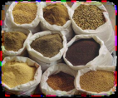
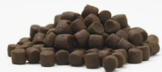
Steps in Feed Manufacture
1.Raw Material Intake
2. Batching (weighing)
3. Grinding
4. Mixing and Conditioning
5. Forming (Extrusion/Pelleting)
6. Drying, Screening, Coating and Cooling
7. Packing, QC and Storage
Intake
Process
Pack

Slide 54
Steps in Feed Manufacture
1.Raw Material Intake
This follows receiving/sources of various raw materials needed for the formulation of fish feed.

Slide 55
Steps in Feed Manufacture
2. Batching (weighing)
Once the raw materials are available and known that they are appropriate for feed formulation, they are weighed according to the quantity of feed to be formulated.
Scales are used in order to be accurate and avoid mistakes

Slide 56
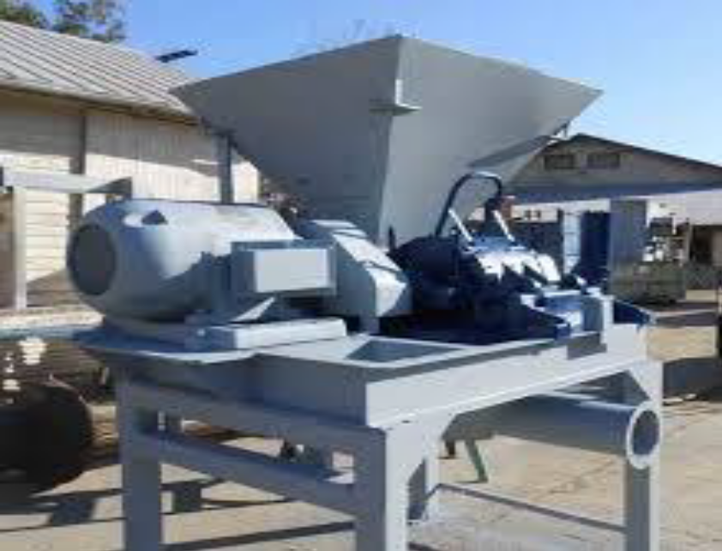
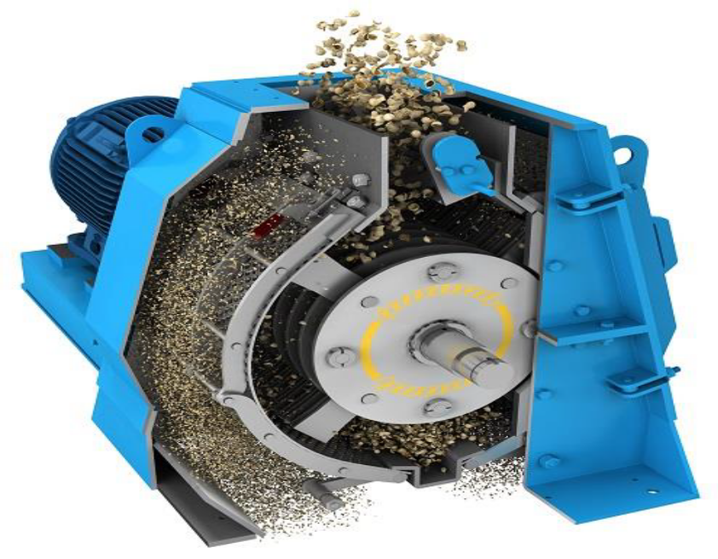
Steps in Feed Manufacture
3. Grinding
Why do you think it is important to grind the ingredients?
A Hammer Mill

Slide 57
Steps in Feed Manufacture
3. Grinding
To icrease the surface area/Reduction of particlesize of ingredients
To reduce differences in the average size of particles from different feed ingredients
To ensure homogeneity of a mixture
Very vital in facilitating conditioning and pelleting
To ensure that individual feed pellets contain all nutrients

Slide 58
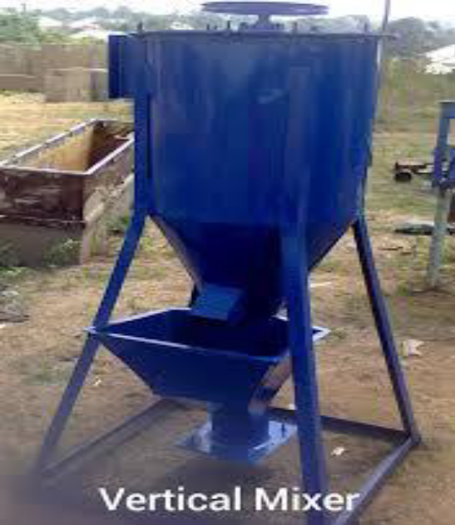
Steps in Feed Manufacture
4. Mixing and Conditioning
This is done ensure homogeneous mix of dry ingredients.
Over mixing (mixingfortoolongperiod) can make particles begin to segregate based on material density.
Undermixing can compromise homogeneity of mixture.

Slide 59
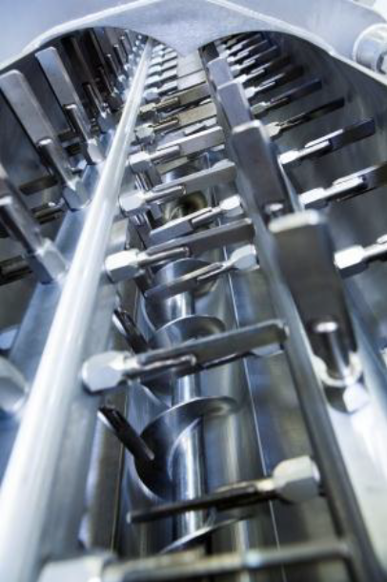
Steps in Feed Manufacture
4. Mixing and Conditioning
Conditioning is key because it helps to prepare a feed mixture for pelleting increasing the moisture content, heating the mixture and this is done in a chamber ( to which steam and physical agitation are introduced)
The mixture then enters either a compression pelleting chamber or an extrusion barrel.

Slide 60
Steps in Feed Manufacture
5. Forming (Extrusion/Pelleting)
Uses a static roller to force a feed mixture that has been exposed to dry steam through tapered holes in a rotating metal die.
Compression of the mixture into dense threads that are cut off by a stationary knife as they emerge from the outside surface of the rotating die and pellet diameter and length can be adjusted
Compression pellets are also referred to as sinking pellets as they have higher density than extruded pellets

Slide 61
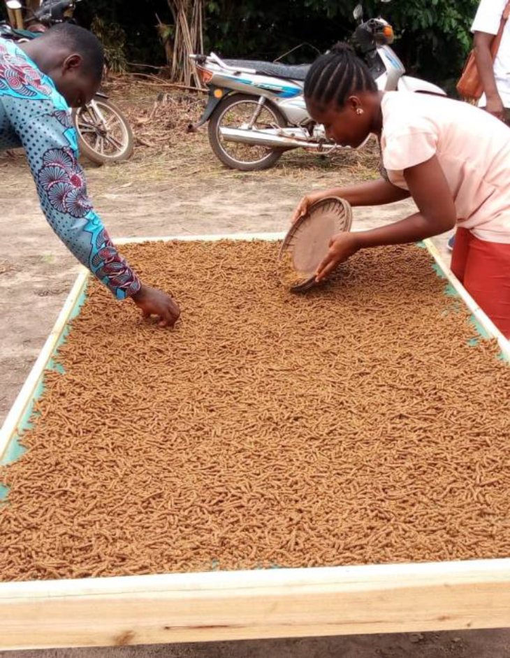
Steps in Feed Manufacture
6. Drying or Cooling
As the pellets come out of the die, there is need to dry them either through exposing them to the sunlight (Small scale) or within the pelletizers or extruder through counterflow dryers.

Slide 62
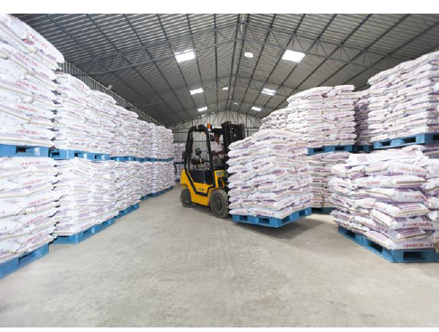
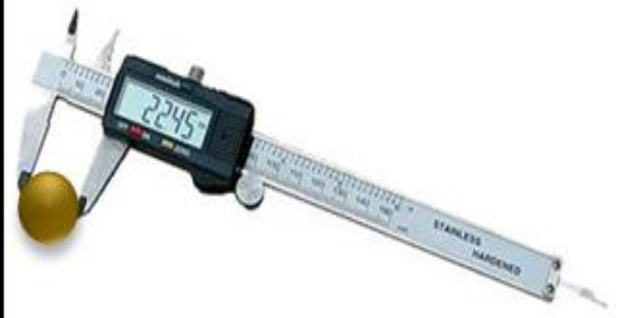
Steps in Feed Manufacture
7. Packing and storage
The feed will then be packaged in various sizes depending on the needs of the market and the aim is to keep feed as dry/cool as possible.
There is quality control through proximate analysis (Checking the nutritional values of the final product)
A variety of physical tests are done (Pellet size, Water stability,Durability)

Slide 63
PHYSICAL PROPERTIES OF FISH FEED
Pellets need to be stable in water until consumed by the target animal
Good pellet stability is required for slow feeding species such as shrimp
Particle size is important to insure appropriate consumption
Sinking and floating properties of the pellets can also be an important requirement of the farmer (and the animal)

Slide 64
ASSIGNMENT TOPICS
How to appropriately store aqua feed
Methods of fish feed production
How to deliver feed to the fish/aquatic organisms

Slide 65
END
THANK YOU FOR YOUR ATTENTION

